Slide 1

Country’s GDP Analysis
Name – Aditya Sahu
Registration -11702583
Section – KM062
Group - 2
Introduction to Data Management
INT 217

Slide 2
Introduction to Data Analysis
Data Analysis is a process of collecting, transforming, cleaning, and modelling data with the goal of discovering the required information.
The results so obtained are communicated, suggesting conclusions, and supporting decision-making.
Data visualization is at times used to portray the data for the ease of discovering the useful patterns in the data.
Data that is processed, organized and cleaned would be ready for the analysis. Various data analysis techniques are available to understand, interpret, and derive conclusions based on the requirements. Data Visualization may also be used to examine the data in graphical format, to obtain additional insight regarding the messages within the data.
Statistical Data Models such as Correlation, Regression Analysis can be used to identify the relations among the data variables. These models that are descriptive of the data are helpful in simplifying analysis and communicate results.
The process might require additional Data Cleaning or additional Data Collection, and hence these activities are iterative in nature.

Slide 3
Introduction to Country’s GDP Analysis
Gross domestic product (GDP) is one of the most common indicators used to track the health of a nation's economy. It includes a number of different factors such as consumption and investment. In this short article, we look at why GDP is such an important economic factor, and what it means for both economists and investors.
Objectives of the Analysis
Country wise Generation
Capita per generations
Suicide Rates country wise
Sex wise suicide rate
Suicide per 100k pop
Sum of suicides/100k pop by age
top 10 Per capita
TOP 10 GDP
Population Age wise

Slide 4
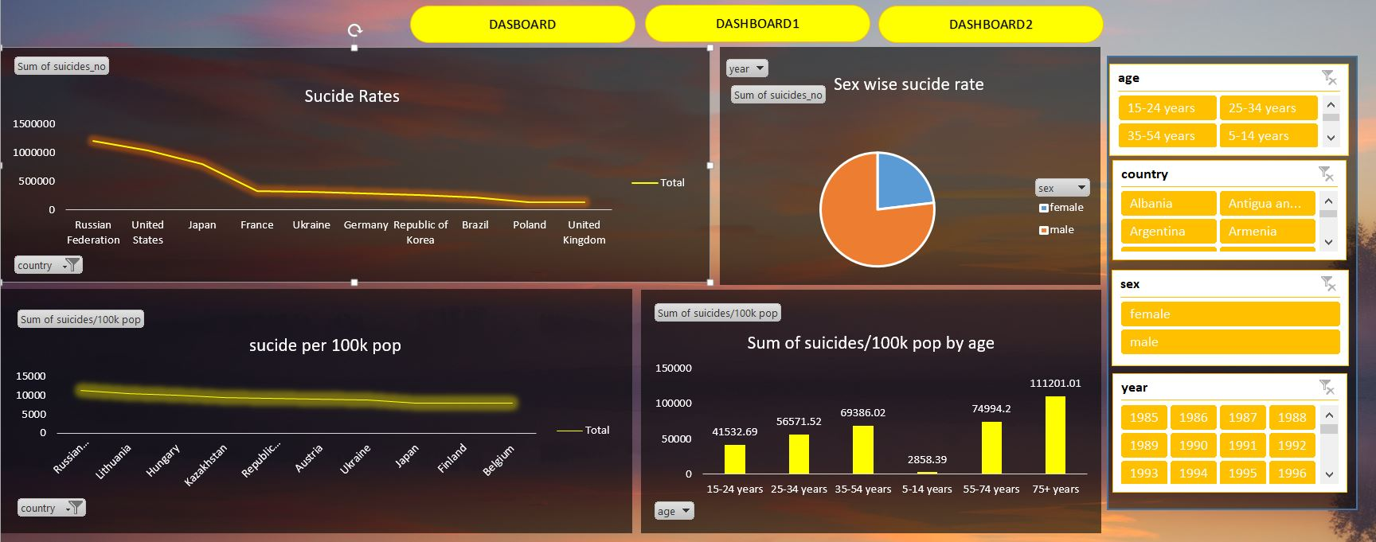

Slide 5
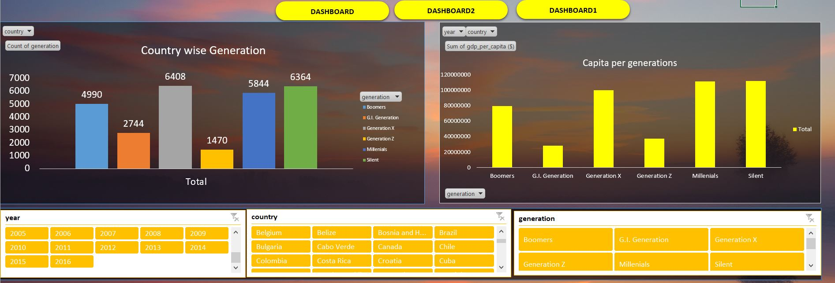

Slide 6
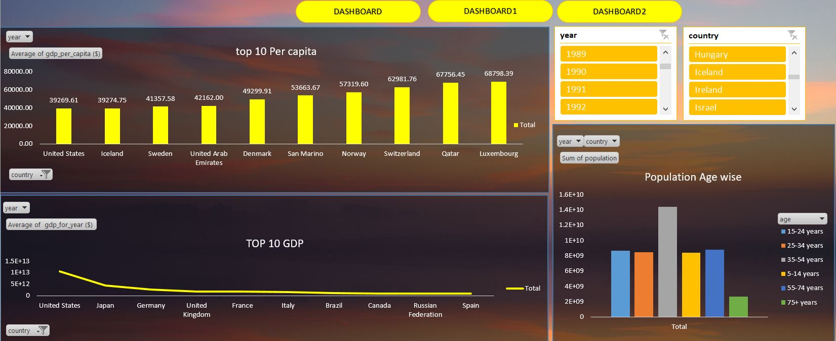

Slide 7
TOP 10 PER CAPITA
Country and Year wise
Representation – Bar Graph
TOP 10 GDP
Country and Year wise
Representation – Line Chart

Slide 8
Population Age Wise
Country and Age Wise
Representation – Bar Graph
Sex wise Suicide Rate
Male , Female and year wise
Representation – Pie Chart

Slide 9
Suicides Rates
Country Wise Total
Representation – Line chart
Suicides Rates/100k by age
Age wise Suicides
Representation – Bar Chart

Slide 10
Suicide per 100k Population
Country Wise
Representation – Line chart
Country wise Generation
Generation vs Total values
Representation – Bar Chart

Slide 11
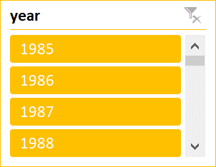
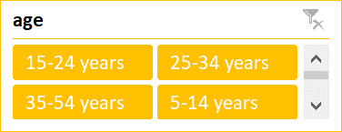
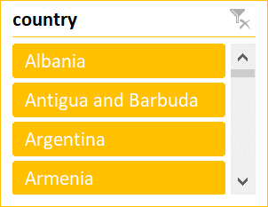

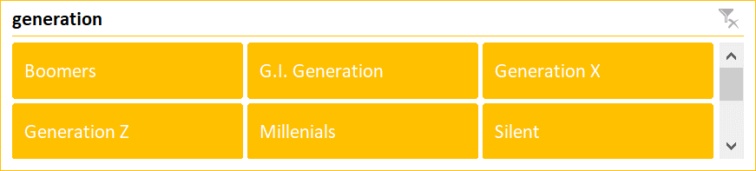
Slicers

Slide 12


